Slide 1
Buffer Overflow and
Stack Smashing
CS 345
Vitaly Shmatikov
slide <number>

Slide 2
Reading Assignment
“Smashing the Stack for Fun and Profit” by Aleph One
  Linked from the course website
Homework 2 can be done in 2-student teams
slide <number>

Slide 3
A Bit of History: Morris Worm
Worm was released in 1988 by Robert Morris
  Graduate student at Cornell, son of NSA chief scientist
  Convicted under Computer Fraud and Abuse Act, sentenced to 3 years of probation and 400 hours of community service
  Now a computer science professor at MIT
Worm was intended to propagate slowly and harmlessly measure the size of the Internet
Due to a coding error, it created new copies as fast as it could and overloaded infected machines
$10-100M worth of damage
slide <number>

Slide 4
Morris Worm and Buffer Overflow
One of the worm’s propagation techniques was a buffer overflow attack against a vulnerable version of fingerd on VAX systems
  By sending special string to finger daemon, worm caused it to execute code creating a new worm copy
  Unable to determine remote OS version, worm also attacked fingerd on Suns running BSD, causing them to crash (instead of spawning a new copy)
slide <number>

Slide 5
Famous Buffer Overflow Attacks
Morris worm (1988): overflow in fingerd
  6,000 machines infected (10% of existing Internet)
CodeRed (2001): overflow in MS-IIS server
  300,000 machines infected in 14 hours
SQL Slammer (2003): overflow in MS-SQL server
  75,000 machines infected in 10 minutes (!!)
Sasser (2004): overflow in Windows LSASS
  Around 500,000 machines infected
Conficker (2008-09): overflow in Windows Server
  Around 10 million machines infected (estimates vary)
Responsible for user
authentication in Windows
slide <number>

Slide 6
Why Are We Insecure?
[Chen et al. 2005]
126 CERT security advisories (2000-2004)
Of these, 87 are memory corruption vulnerabilities
73 are in applications providing remote services
  13 in HTTP servers, 7 in database services, 6 in remote login services, 4 in mail services, 3 in FTP services
Most exploits involve illegitimate control transfers
  Jumps to injected attack code, return-to-libc, etc.
  Therefore, most defenses focus on control-flow security
But exploits can also target configurations, user data and decision-making values
slide <number>

Slide 7
Memory Exploits
Buffer is a data storage area inside computer memory (stack or heap)
  Intended to hold pre-defined amount of data
  If executable code is supplied as “data”, victim’s machine may be fooled into executing it
    Code will self-propagate or give attacker control over machine
Attack can exploit any memory operation
  Pointer assignment, format strings, memory allocation and de-allocation, function pointers, calls to library routines via offset tables
slide <number>

Slide 8
Stack Buffers
Suppose Web server contains this function
void func(char *str) {
char buf[126];
strcpy(buf,str);
}
When this function is invoked, a new frame with local variables is pushed onto the stack
Allocate local buffer
(126 bytes reserved on stack)
Copy argument into local buffer
Stack grows this way
buf
sfp
ret
addr
str
Frame of the
calling function
Top of
stack
Local variables
Pointer to
previous
frame
Arguments
Execute code
at this address
after func() finishes
slide <number>

Slide 9
What If Buffer is Overstuffed?
Memory pointed to by str is copied onto stack…
void func(char *str) {
char buf[126];
strcpy(buf,str);
}
If a string longer than 126 bytes is copied into buffer, it will overwrite adjacent stack locations
strcpy does NOT check whether the string
at *str contains fewer than 126 characters
buf
overflow
str
Frame of the
calling function
Top of
stack
This will be
interpreted
as return address!
slide <number>

Slide 10
Executing Attack Code
Suppose buffer contains attacker-created string
  For example, *str contains a string received from the network as input to some network service daemon
When function exits, code in the buffer will be
executed, giving attacker a shell
  Root shell if the victim program is setuid root
code
ret
str
Top of
stack
Frame of the
calling function
Attacker puts actual assembly
instructions into his input string, e.g.,
binary code of execve(“/bin/sh”)
In the overflow, a pointer back
into the buffer appears in
the location where the system
expects to find return address
slide <number>

Slide 11
Stack Corruption (Redux)
int bar (int val1) {
int val2;
foo (a_function_pointer);
}
val1
val2
arguments (funcp)
return address
Previous Frame Pointer
pointer var (ptr)
buffer (buf)
String grows
Contaminated memory
int foo (void (*funcp)()) {
char* ptr = point_to_an_array;
char buf[128];
gets (buf);
strncpy(ptr, buf, 8);
(*funcp)();
}
Most popular target
Stack grows
slide <number>

Slide 12
Attack #1: Return Address
args (funcp)
return address
PFP
pointer var (ptr)
buffer (buf)
② set stack pointers to return to a dangerous library function
Attack code
“/bin/sh”
①
system()
Change the return address to point to the attack code. After the function returns, control is transferred to the attack code
… or return-to-libc: use existing instructions in the code segment such as system(), exec(), etc. as the attack code
slide <number>

Slide 13
Buffer Overflow Issues
Executable attack code is stored on stack, inside the buffer containing attacker’s string
  Stack memory is supposed to contain only data, but…
For the basic attack, overflow portion of the buffer must contain correct address of attack code in the RET position
  The value in the RET position must point to the beginning of attack assembly code in the buffer
    Otherwise application will crash with segmentation violation
  Attacker must correctly guess in which stack position his buffer will be when the function is called
slide <number>

Slide 14
Problem: No Range Checking
strcpy does not check input size
  strcpy(buf, str) simply copies memory contents into buf starting from *str until “\0” is encountered, ignoring the size of area allocated to buf
Many C library functions are unsafe
  strcpy(char *dest, const char *src)
  strcat(char *dest, const char *src)
  gets(char *s)
  scanf(const char *format, …)
  printf(const char *format, …)
slide <number>

Slide 15
Does Range Checking Help?
strncpy(char *dest, const char *src, size_t n)
  If strncpy is used instead of strcpy, no more than n characters will be copied from *src to *dest
    Programmer has to supply the right value of n
Potential overflow in htpasswd.c (Apache 1.3):
… strcpy(record,user);
strcat(record,”:”);
strcat(record,cpw); …
Published “fix” (do you see the problem?):
… strncpy(record,user,MAX_STRING_LEN-1);
strcat(record,”:”);
strncat(record,cpw,MAX_STRING_LEN-1); …
Copies username (“user”) into buffer (“record”),
then appends “:” and hashed password (“cpw”)
slide <number>

Slide 16
Misuse of strncpy in htpasswd “Fix”
Published “fix” for Apache htpasswd overflow:
… strncpy(record,user,MAX_STRING_LEN-1);
strcat(record,”:”);
strncat(record,cpw,MAX_STRING_LEN-1); …
MAX_STRING_LEN bytes allocated for record buffer
contents of *user
:
contents of *cpw
Put up to MAX_STRING_LEN-1
characters into buffer
Put “:”
Again put up to MAX_STRING_LEN-1
characters into buffer
slide <number>

Slide 17
Attack #2: Pointer Variables
args (funcp)
return address
PFP
pointer var (ptr)
buffer (buf)
Attack code
Global Offset Table
Function pointer
Change a function pointer to point to the attack code
Any memory, even not in the stack, can be modified by the statement that stores a value into the compromised pointer
strncpy(ptr, buf, 8);
*ptr = 0;
slide <number>

Slide 18
Off-By-One Overflow
Home-brewed range-checking string copy
void notSoSafeCopy(char *input) {
char buffer[512]; int i;
for (i=0; i<=512; i++)
buffer[i] = input[i];
}
void main(int argc, char *argv[]) {
if (argc==2)
notSoSafeCopy(argv[1]);
}
This will copy 513
characters into
buffer. Oops!
1-byte overflow: can’t change RET, but can change pointer to previous stack frame
  On little-endian architecture, make it point into buffer
  RET for previous function will be read from buffer!
slide <number>

Slide 19
Attack #3: Frame Pointer
args (funcp)
return address
PFP
pointer var (ptr)
buffer (buf)
return address
PFP
Attack code
Change the caller’s saved frame pointer to point to attack-controlled memory. Caller’s return address will be read from this memory.
slide <number>

Slide 20
Two’s Complement
Binary representation of negative integers
Represent X (where X<0) as 2^{N}-|X|
  N is word size (e.g., 32 bits on x86 architecture)
1
0
0
0
0
…
0
1
2³¹-1
0
1
1
1
1
1
…
-1
1
1
1
1
1
1
…
2³¹ ??
-2
1
1
1
1
1
0
…
-2³¹
1
0
0
0
0
0
…
slide <number>

Slide 21
Integer Overflow
static int getpeername1(p, uap, compat) {
// In FreeBSD kernel, retrieves address of peer to which a socket is connected
…
struct sockaddr *sa;
…
len = MIN(len, sa->sa_len);
… copyout(sa, (caddr_t)uap->asa, (u_int)len);
…
}
Checks that “len” is not too big
Negative “len” will always pass this check…
… interpreted as a huge
unsigned integer here
Copies “len” bytes from
kernel memory to user space
… will copy up to 4G of
kernel memory
slide <number>

Slide 22
Heap Overflow
Overflowing buffers on heap can change pointers that point to important data
  Sometimes can also transfer execution to attack code
    For example, December 2008 attack on XML parser in Internet Explorer 7 - see http://isc.sans.org/diary.html?storyid=5458
Illegitimate privilege elevation: if program with overflow has sysadm/root rights, attacker can use it to write into a normally inaccessible file
  For example, replace a filename pointer with a pointer into buffer location containing name of a system file
    Instead of temporary file, write into AUTOEXEC.BAT
slide <number>

Slide 23
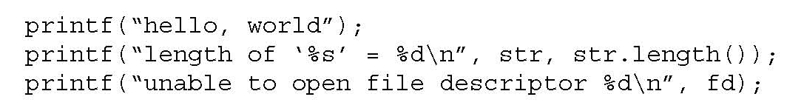
Variable Arguments in C
In C, can define a function with a variable number of arguments
  Example: void printf(const char* format, …)
Examples of usage:
Format specification encoded by
special %-encoded characters
%d,%i,%o,%u,%x,%X – integer argument
%s – string argument
%p – pointer argument (void *)
Several others
slide <number>

Slide 24
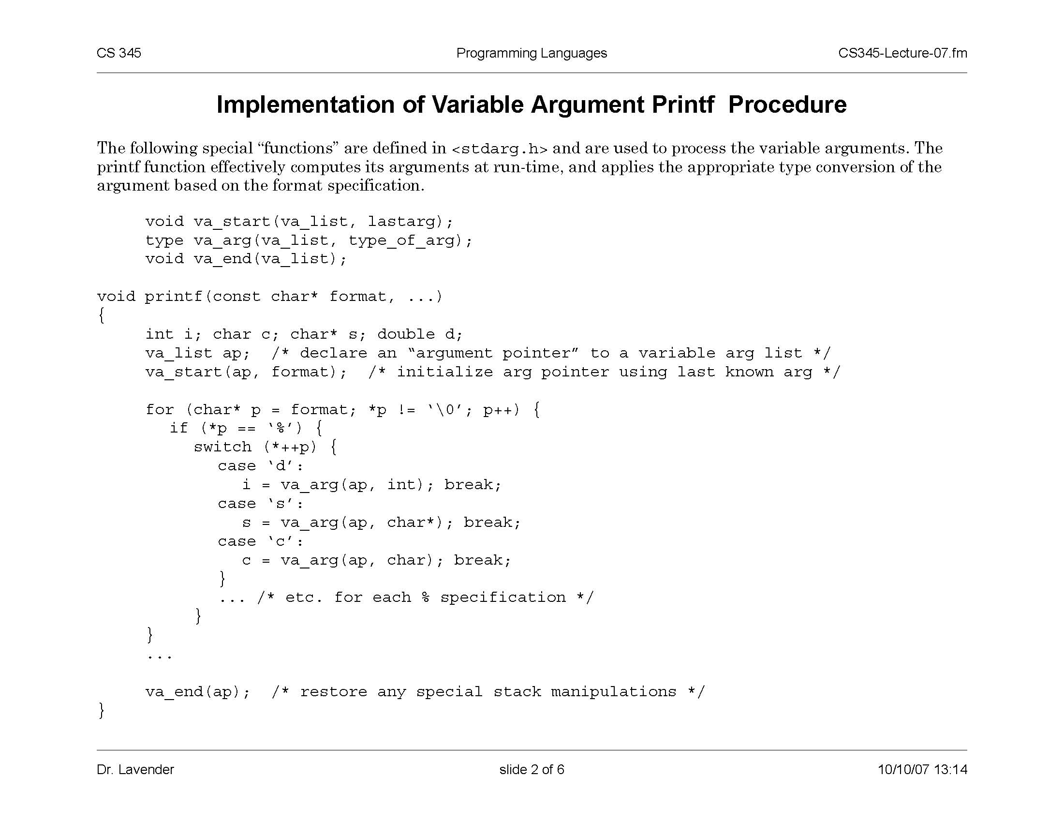
Implementation of Variable Args
Special functions va_start, va_arg, va_end compute arguments at run-time (how?)
slide <number>

Slide 25
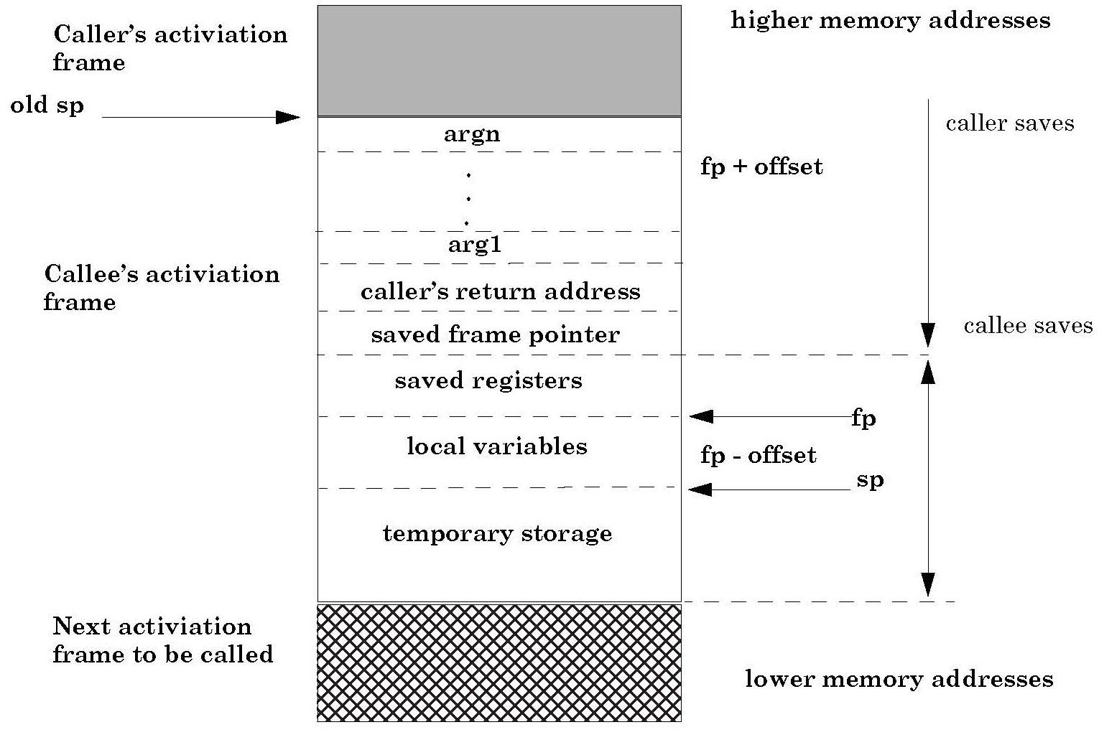
Activation Record for Variable Args
va_arg(ap,type)
retrieves next arg
from offset ap
va_start computes
location on the stack
past last statically
known argument
slide <number>

Slide 26
Format Strings in C
Proper use of printf format string:
… int foo=1234;
printf(“foo = %d in decimal, %X in hex”,foo,foo); …
    This will print
    foo = 1234 in decimal, 4D2 in hex
Sloppy use of printf format string:
… char buf[13]=“Hello, world!”;
printf(buf);
// should’ve used printf(“%s”, buf); …
    If the buffer contains a format symbol starting with %, location
    pointed to by printf’s internal stack pointer will be interpreted
    as an argument of printf. This can be exploited to move
    printf’s internal stack pointer!
slide <number>

Slide 27
Writing Stack with Format Strings
%n format symbol tells printf to write the number of characters that have been printed
… printf(“Overflow this!%n”,&myVar); …
    Argument of printf is interpeted as destination address
    This writes 14 into myVar (“Overflow this!” has 14 characters)
What if printf does not have an argument?
… char buf[16]=“Overflow this!%n”;
printf(buf); …
    Stack location pointed to by printf’s internal stack pointer will be interpreted as address into which the number of characters will be written!
slide <number>

Slide 28
Using %n to Mung Return Address
This portion contains
enough % symbols
to advance printf’s
internal stack pointer
Buffer with attacker-supplied
input string
“… attackString%n”, attack code
&RET
RET
Number of characters in
attackString must be
equal to … what?
Overwrite location under printf’s stack
pointer with RET address;
printf(buffer) will write the number of
characters in attackString into RET
Return
execution to
this address
C has a concise way of printing multiple symbols: %Mx will print exactly M bytes (taking them from the stack). If attackString contains enough “%Mx” so that its total length is equal to the most significant byte of the address of the attack code, this byte will be written into &RET.
Repeat three times (four “%n” in total) to write into &RET+1, &RET+2, &RET+3, replacing RET with the address of attack code.
See “Exploting Format String Vulnerabilities” for details
slide <number>

Slide 29
Other Targets of Memory Exploits
Configuration parameters
  E.g., directory names that confine remotely invoked programs to a portion of the server’s file system
Pointers to names of system programs
  For example, replace the name of a harmless script with an interactive shell
  This is not the same as return-to-libc (why?)
Branch conditions in input validation code
slide <number>

Slide 30
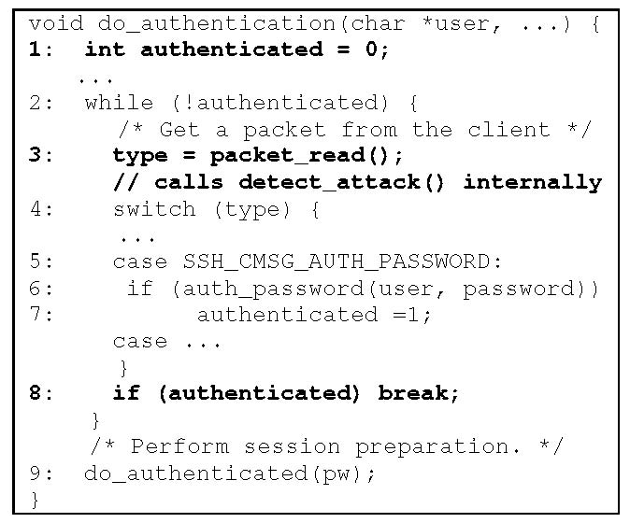
SSH Authentication Code
write 1 here
Loop until one of
the authentication
methods succeeds
detect_attack() prevents
checksum attack on SSH1…
…and also contains an
overflow bug which permits
the attacker to put any value
into any memory location
Break out of authentication
loop without authenticating
properly
slide <number>

